Slide 1


I-Helmet
Initiative towards aiding blind people

Slide 2
Our Vision
Every person should be independent.
Everyone deserves to roam free without restrictions.
Give people a second chance to live their to the fullest.
Try to reduce cost of our project as much as possible.

Slide 3
Problems faced by Visually Impaired people
Visual impairment is a term experts use to describe any kind of vision loss, whether it's someone who cannot see at all or someone who has partial vision loss.
Visual impairment causes people facing difficulties with their real-life chores such as walking, socializing or finding an object.
It deeply affects those who do not have someone to look after them.

Slide 4
What makes our project different?
We want to make everyone independent, live like normal people do.
Cheap solution for helping people overcome their disability.
Most projects cost above 250$, we can make the same thing in less than 150$
Usage of Python with OpenCV and YOLO, all three are open source and free to use.

Slide 5
Components/Section
We have made our own “I-Helmet Assistant”
In our Project, there are several functions:
Real-time Object Detection
Navigation
Basic functions such as asking time
A portion will be used to provide route information.
The helmet’s system can efficiently carry out the instructions introduced to it.

Slide 6
Hardware Requirements:
Raspberry Pi
Main Processing Unit
Pi Camera
As a plug-and-play camera
Battery/ Power Bank
To power the devices
GPS Module
For Getting the location
GSM Module or LTE Shield
For Internet Connection, which will be used for Communication as well as navigation

Slide 7
Why using Raspberry Pi?
Cheap, for as low as 35$
Compact Size
Runs Linux
Easily Customizable
GPIO Pins for connections
In Built Wi-Fi and Bluetooth
Fast Processing

Slide 8
3D Model

Slide 9
Technical Section
Python (Programming Language)
OpenCV (pip package) – For Computer Vision
Numpy – Managing Arrays in OpenCV and YOLO
Math – To locate the object and tell it’s location in frame
Imutils – To manage frame detection
Pyttsx3 (pip package) – For Text to Speech
SpeechRecognition (pip package) – For Speech to Text
Misc. Libraries – Requests, threading, pyfiglet
Google Maps (API) – For Navigation
YOLO Framework (for object detection)
Our Own Deep Learning Network using OpenCV

Slide 10
Start
Command
OpenCV and Yolo Called
Output - Text to Speech
Realtime
Detection
Speech to Text
Object Search
Interpretation
Assistant Interpretation
Extra Functions
Function Called
Google Maps API
Navigation
Logging

Slide 11
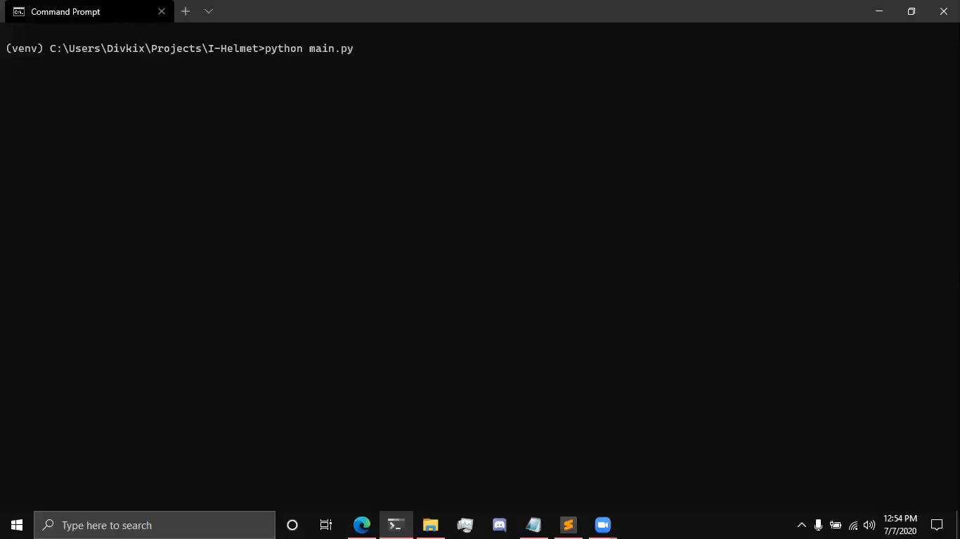
Demonstration

Slide 12
Futuristic Plan
To measure accurate distance from object.
Make it more affordable
To make our own Modified Plug and Play Drive (SD Card) for Raspberry Pi
To improve Detection by integrating Deep Learning by using Google Tensorflow
Android Application (In Progress)
To use another Open Source Navigation System

Slide 13
Contact details:
Team I-Helmet:
teamihelmet@gmail.com
Team Members:
Divanshu Chauhan
Namo Jain
Shikhar Srivastava
Aryan Chauhan

